Slide 1
Crash Course: Local Marketing
How can you connect with local customers?

Slide 2
Google & SEO
Homework
Figure out if volume or competition is more important
Incorporate key words into your website
Advantages
Free
Nearly unlimited potential
Targeted traffic / very close to completing the sale
Disadvantages
Can be time intensive
Unpredictable
No guarantee for results

Slide 3
Directories
Homework
Find the directories that work for your business
AMFIBI.com
HotFrog
Lacartes
Spoke
Localpage.com
Advantages
Long-lasting
Quick to implement
Cost
Help with search engine results
Disadvantages
Usually need another step to convert
Not always detailed
Competition

Slide 4
Social Media
Advantages
Connect directly with consumers
Multiple types of content
Cost
Disadvantages
Constant upkeep
Always changing
Acquisition / Cost
Loss of control

Slide 5
-Facebook
Advantages
Large & Diverse Audience
Paid = extensive targeting options
Analytics
Disadvantages
Time to build up page
Recent algorithm changes
Competition awareness

Slide 6
-Twitter
Advantages
Hashtags
Integrate with current events
Quick to create
Disadvantages
Short lived
Time consuming to keep constant
Limited content / not great visually

Slide 7
-Pinterest
Advantages
Long-lasting
Followers are very passionate
Great for visuals
Disadvantages
Less direct communication
Better for some things (recipes / DIY)
Time consuming to create content

Slide 8
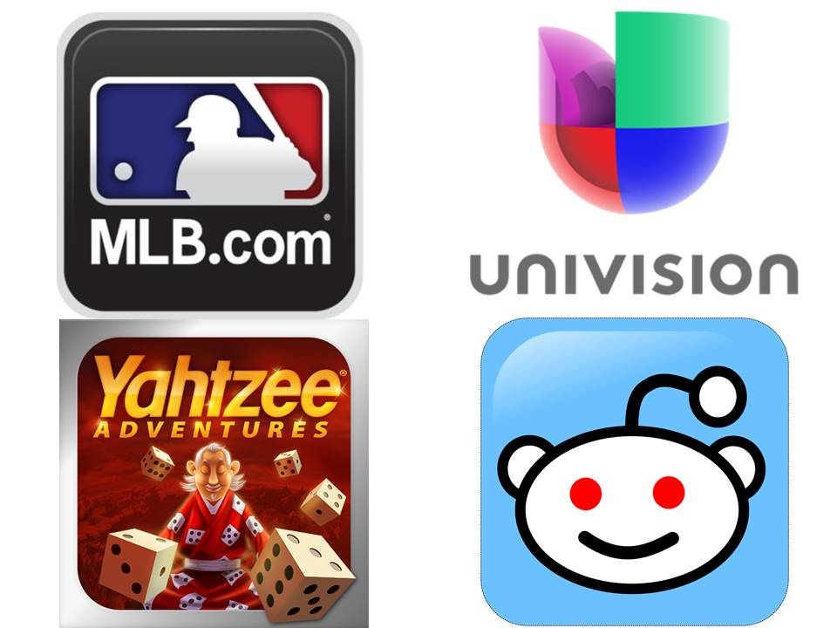
Mobile Marketing
Advantages
GPS Targeting
Always connected
Less Competition
Detailed Stats
Cost-effective
Disadvantages
GPS Targeting
Top-of-mind reference

Slide 9
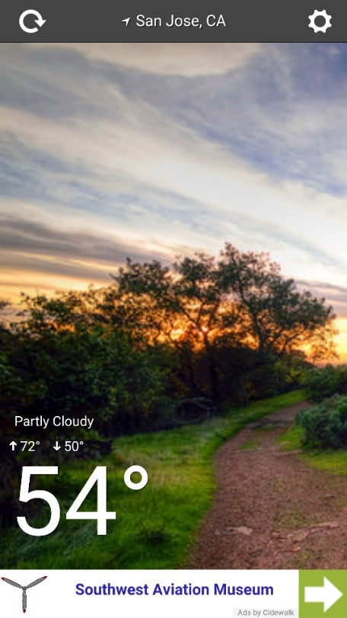
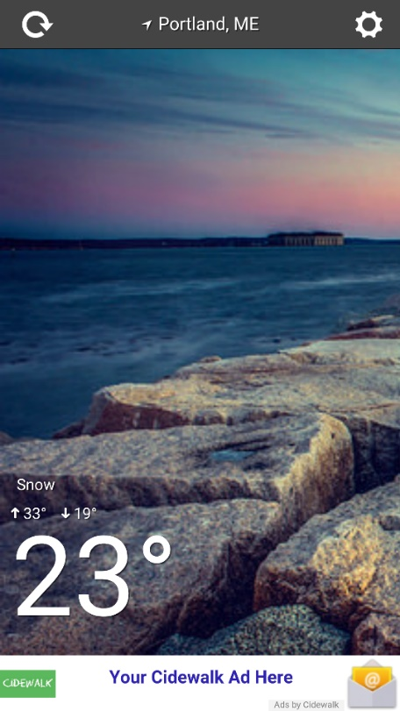
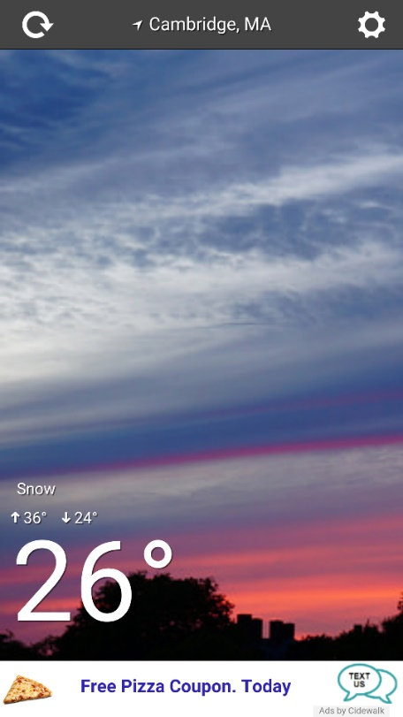
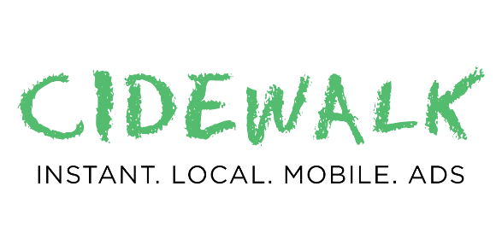
Geo Targeted Local Mobile Ads to Reach New Customers
Click-to-Website Ads Click-to-Email Ads Click-to-Txt Ads

Slide 11
Thank You

